Slide 1
TRACKS: Trafficking Reporting, Analysis, Compilation frameworK System
DataJam Against Exploitation
Notes:
Hi, I'm Cyan from the team, DataLionesses. It's my pleasure to present to you TRACKS: Trafficking Reporting Analysis, Compilation frameworK System, a unique solution to fighting trafficking at the transportation stage.

Slide 2
"The one hour price for “full service” will go from $160-180 per hour in Montreal, but in Edmonton, they can get $200-$300 for the same service. Traffickers picked up on this, and are sending them out for a week or so."
– Law enforcement respondent on human trafficking corridors
Notes:
According to The Canadian Centre to End Human Trafficking, victims of trafficking are routinely relocated. Moving between places ensures that they stay undetected. Victims stay isolated and unable to escape.

Slide 3
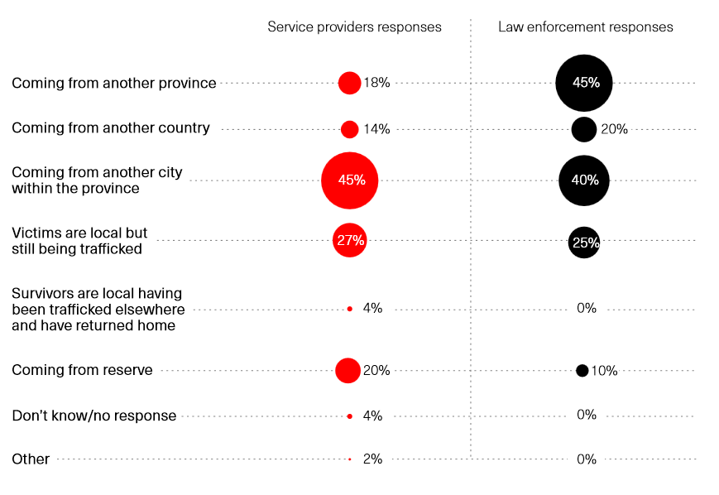
Trafficking Migration patterns
Notes:
While human trafficking remains a persistent global problem, research indicates that much of the trafficking in Canada is done within the country, with a significant portion of instances being inter-city and within a province.

Slide 4
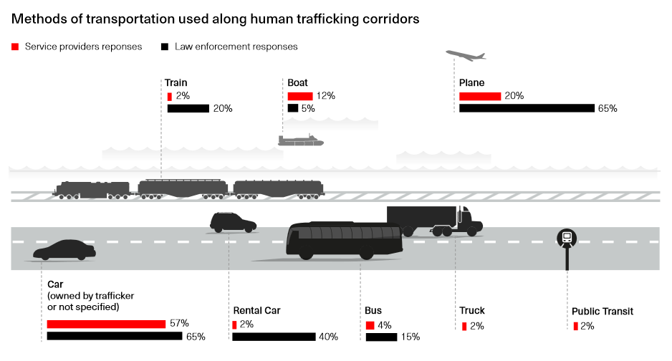
Trafficking Migration patterns
Notes:
The vast majority of trafficking is done by ground transport, which is more flexible and minimizes the chance of discovery by investigators. This presents an opportunity for those who offer such transportation services to be a part of the solution to end human trafficking.

Slide 5




The Team: DataLionesses
Tasneem
Shivani
Cyan
Pouneh
Global Health & AI, Computer Vision
Machine Learning, Data Science
Cognitive Science, Human Computer Interaction
Software Engineering, Machine Learning
Notes:
And that brings us to, ... well..., us. We're a team of machine learning and AI experts who also have a broad range of experiences in areas such as business, UN global health, and the humanities. Together we present to you TRACKS.

Slide 6
TRACKS
3 components
Notes:
Transportation service employees, when witnessing potential trafficking, are often directed to hotlines which can test their patience. Also, verbal reports rely on having highly trained phone operators in order such that relevant, high-quality data can be extracted. TRACKS is a platform-agnostic digital framework which uses location information and powerful prediction methods in order to help witnesses in the transportation industry identify and report potential trafficking, as well as law enforcement in prioritizing reports to follow up on.

Slide 7
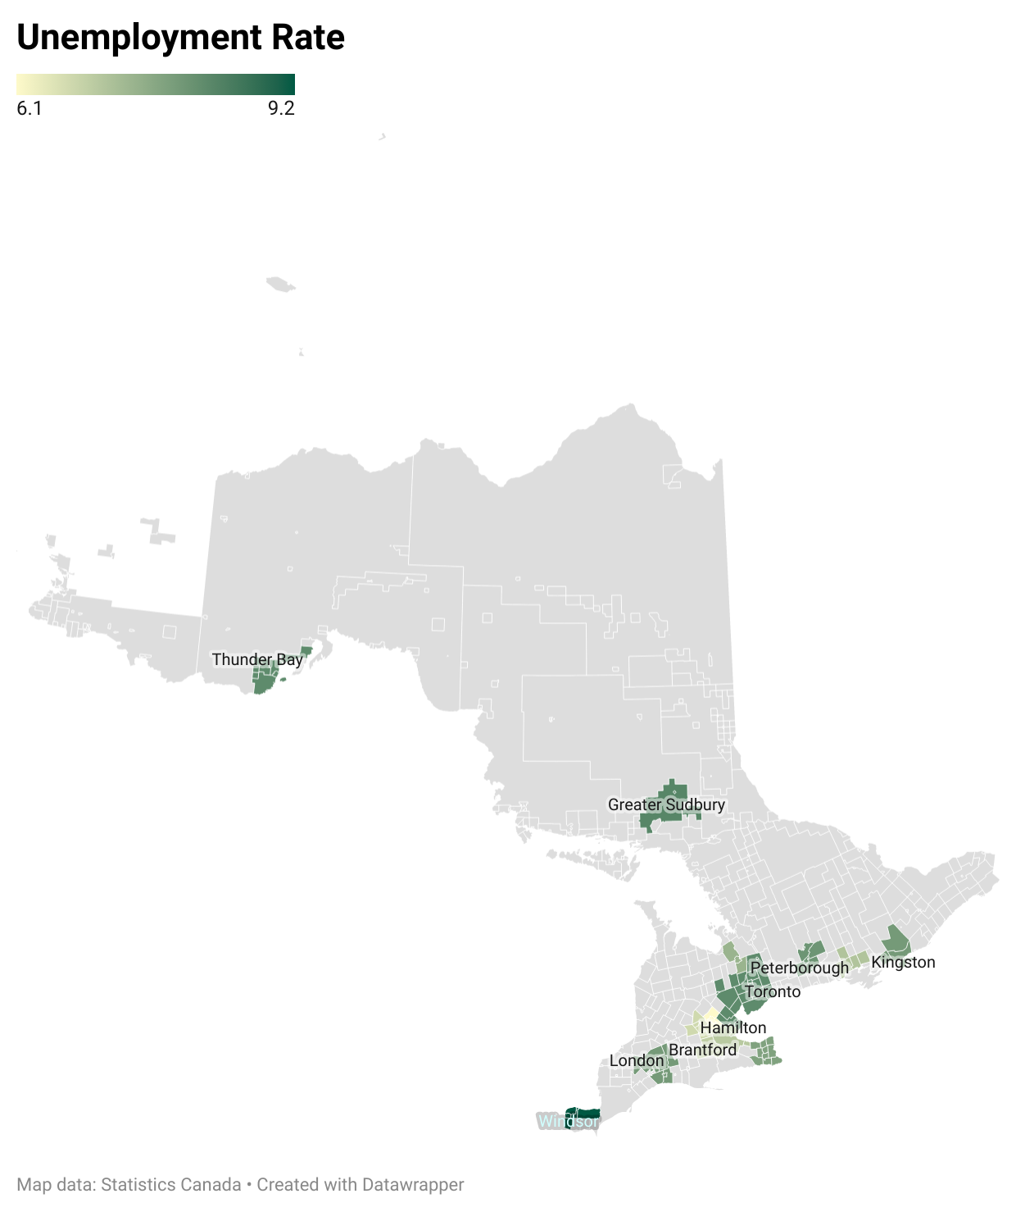
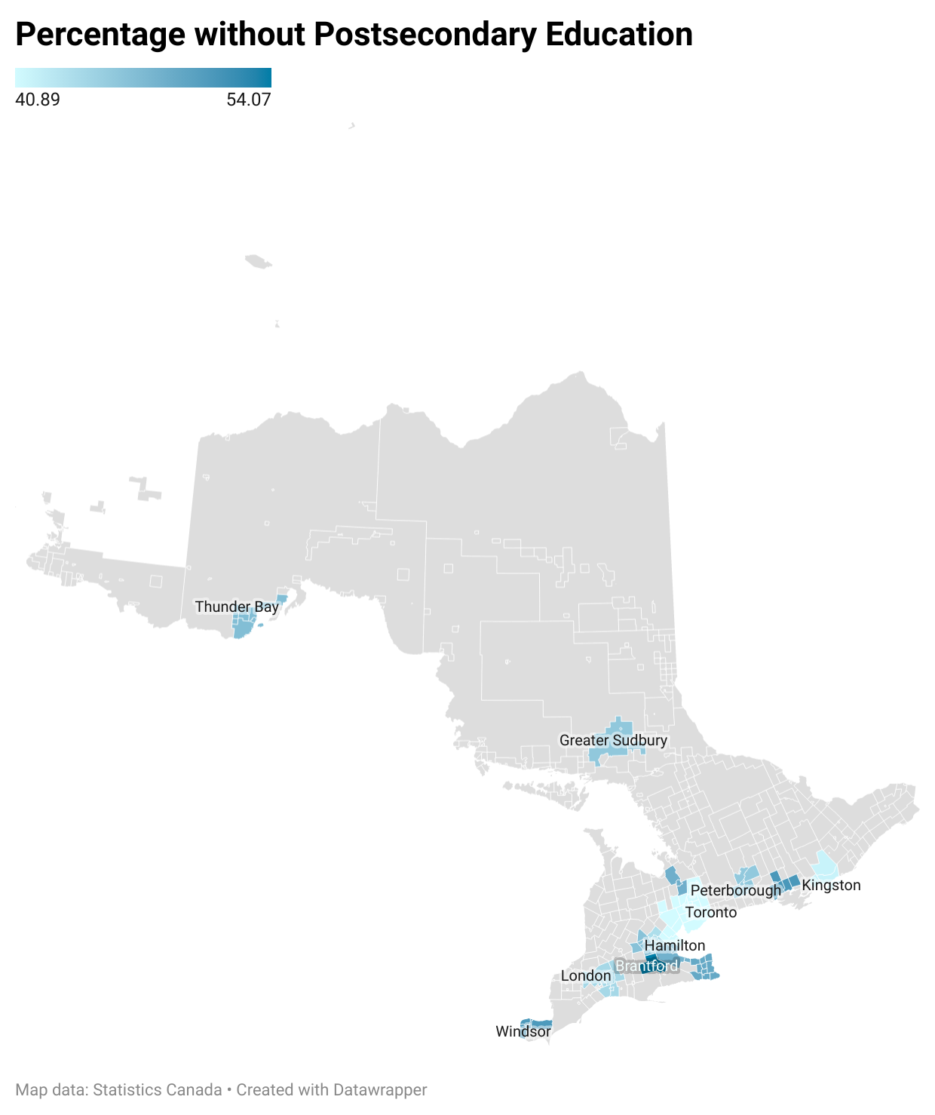
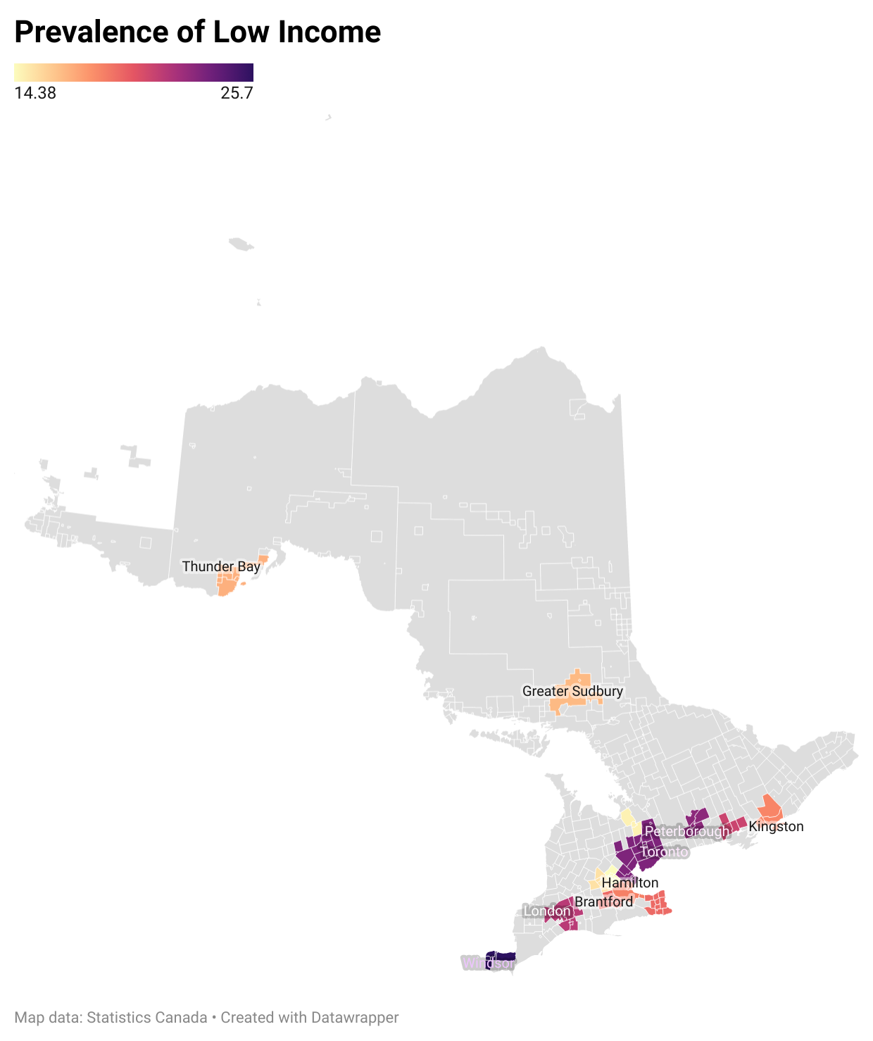
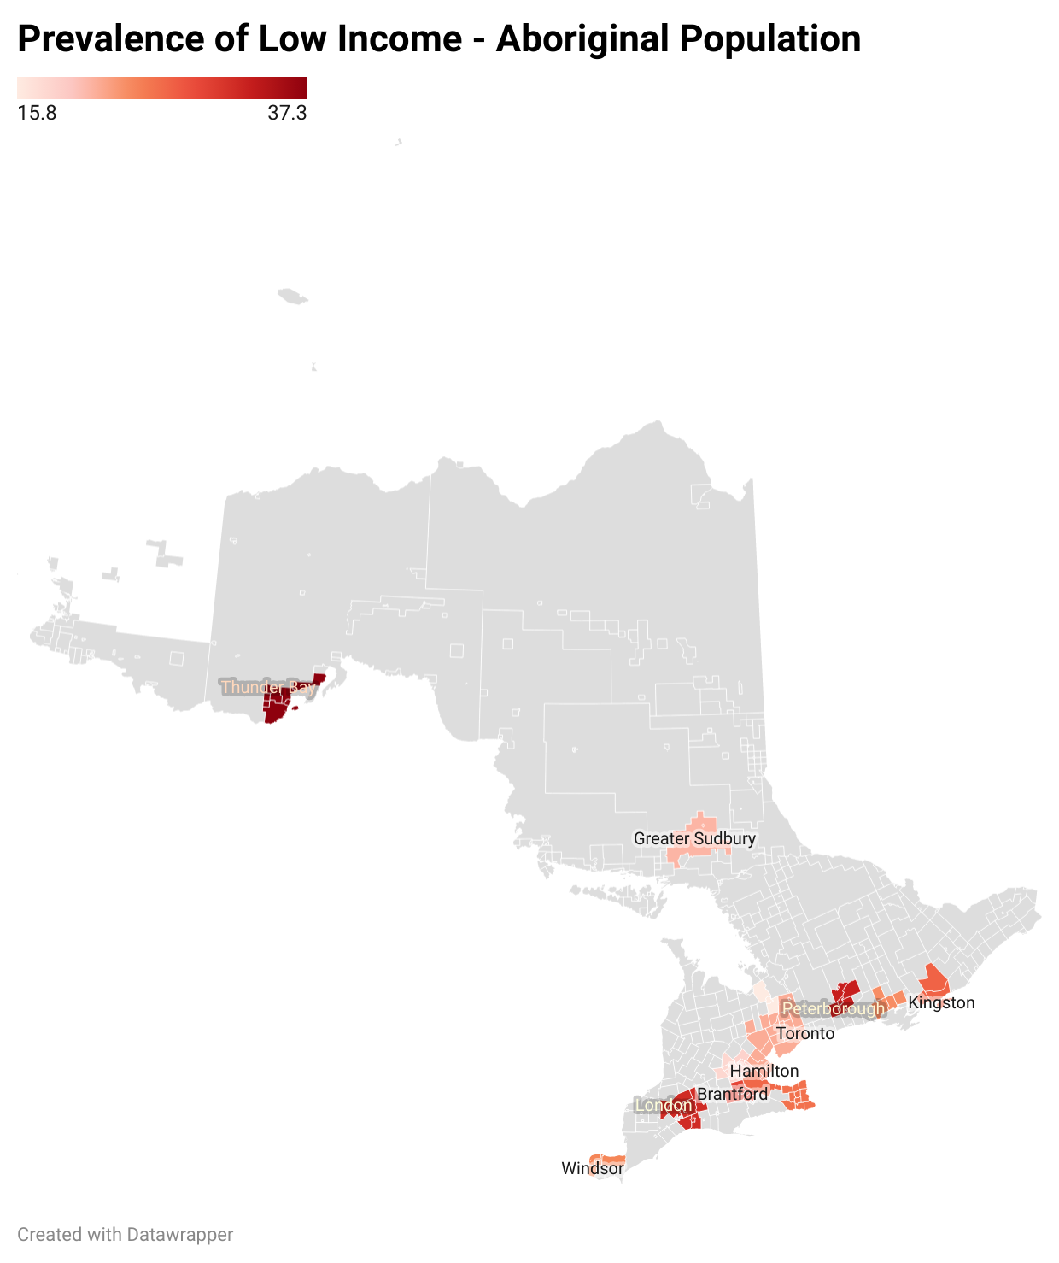
Identifying and Flagging High Risk Areas
Regions of Ontario by factors used in modeling
Notes:
Using trip start and destination locations taken from GPS and known transportation hubs, we utilize a model trained on a subset of these factors to flag trips to and from locations that are suspicious.
Currently our focus is on Southern Ontario. To protect our aboriginal population, our method accounts for areas close to indigenous reserves, which are uniquely at risk. By prompting potential witnesses, this framework takes an active approach to combating trafficking.

Slide 8
Features Labels
Low-income status - applicable
Unemployed
Trafficking incidents
Aboriginal Low-income status - applicable
Sexual exploitation incidents
Notes:
Using Census data, we found that trafficking incidents were linearly correlated with unemployment, no post-secondary education, below-poverty-line income and aboriginal status.
These extracted features, explaining a majority of the variance in the risk calculation of an area, form the basis of our model.

Slide 9
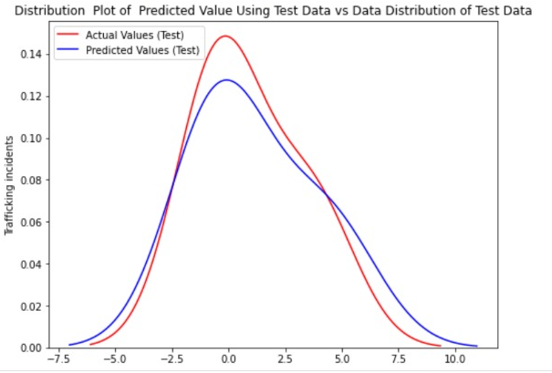
Modeling
Notes:
We tested this linear regression model by bootstrapping. Our model's error rate sits at 0.39, when the predicted trafficking incidents were compared with the actual trafficking incidents for the test data. This gives us confidence that it accurately predicts which areas carry a high risk of trafficking, so long as census data on those factors exist.

Slide 10
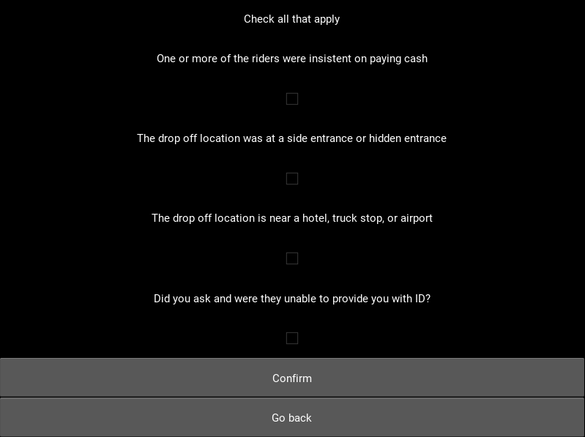
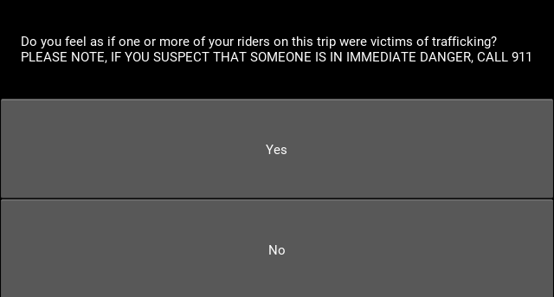
Reporting forms
Example screenshots of the reporting tool
Notes:
Knowing when to report a case is sometimes difficult for witnesses, and on the law enforcement side, it's often hard to prioritize which cases to follow up on. To address this, our front end asks users to confirm the presence of indicators from the UNODC.

Slide 11
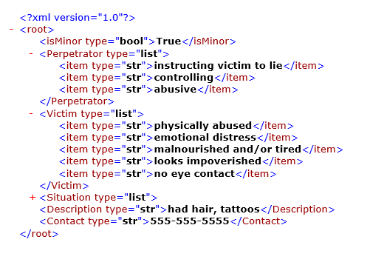
Investigation and Follow-up
A sample report using xml for flexibility when using web platforms
Notes:
The indicators as reported by the witness, contact information and additional details are compiled into an easy to-integrate report which is then sent to authorities to follow up.

Slide 12
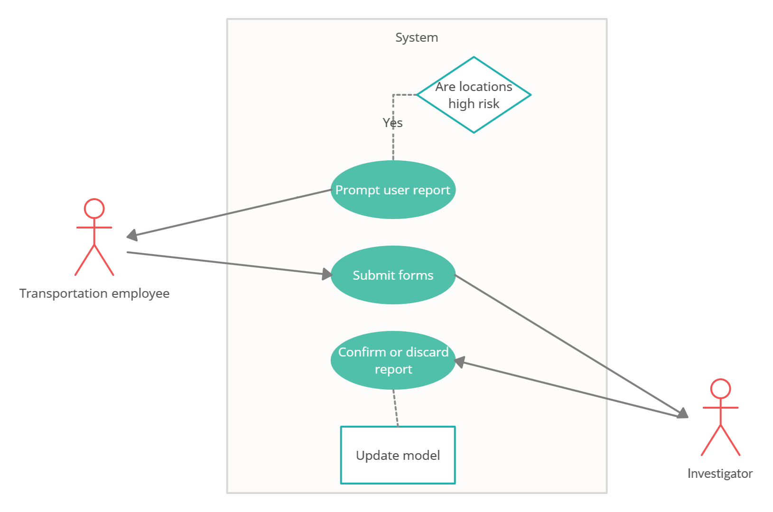
Use Case
Notes:
This is how this all comes together: A flagged trip triggers a notification on a phone or computer asking a witness whether or not they experienced anything suspicious during the trip. Answering 'yes' takes them to the series of reporting forms.
Here we would like to invite trafficking investigators to collaborate with us on this framework, so that we can utilize follow up information to update our model, leading to better detection.

Slide 13
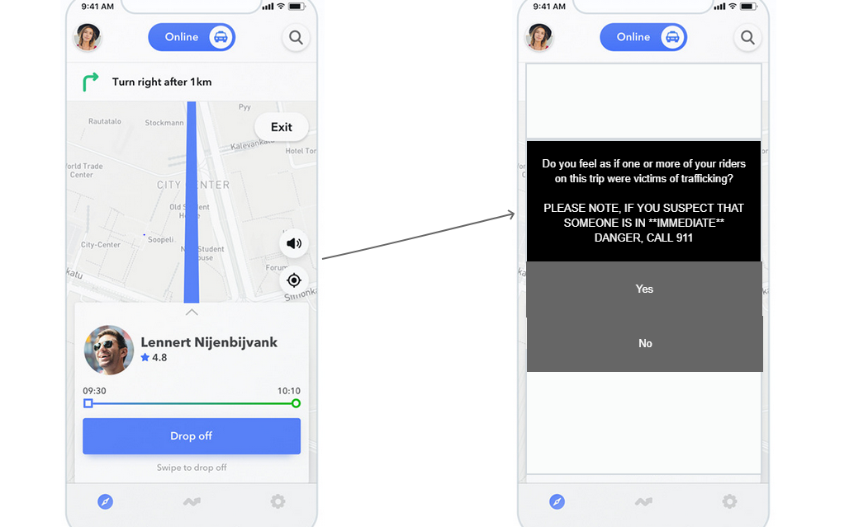
Deployment Strategy
Collaborate with law enforcement, gain insights
Persuade companies to have drivers install as a standalone app
Or integrate with existing apps (preferred)
Notes:
The truly remarkable thing about TRACKS is that it can be realized on a number of different platforms. Whether it's a plugin for ride share app, or a desktop widget for rental clerks, or even a standalone app. In any case, we think that law enforcement will find this tool useful, and hope that transportation professionals who are dedicated to the fight against trafficking will adopt this framework.

Slide 14
Potential
Can be used in other provinces/interprovincial routes
Can be modified to reflect different country’s needs
Uber, Ride-sharing is popular not only in CA but other countries as well, integrate
Notes:
This isn't it for TRACKS. What we've done here can be easily expanded to include other provinces and interprovincial routes. With some additional research on factors indicating vulnerability, we can modify aspects of TRACKS to reflect the needs of other countries. Thank you.

Slide 15
Sources
Content from this video is taken from Human-Trafficking Corridors in Canada document by The Canadian Centre to End Human Trafficking. (https://www.canadiancentretoendhumantrafficking.ca/wp-content/uploads/2021/02/Human-Trafficking-Corridors-in-Canada-Report.pdf)
Additional sources: UNODC indicators of trafficking, (https://www.unodc.org/pdf/HT_indicators_E_LOWRES.pdf)

